Slide 1
IDENTIFICATION OF ARRHYTHMIA USING ELECTROCARDIOGRAM DATA
Presented By:
Group - 4
Aman Agarwal (20155066)
Deepanjan Saha (20152048)
Pawan Kumar Thapa (20155032)
Under guidance of
Prof. Haranath Kar
DEPARTMENT OF ELECTRONICS AND COMMUNICATION ENGINEERING
MOTILAL NEHRU NATIONAL INSTITUTE OF TECHNOLOGY ALLAHABAD
PRAYAGRAJ-211004, INDIA

Slide 2
CONTENT
INTRODUCTION
MOTIVATION
DATASET
WORKFLOW
WORK DONE
TOOLS/ LIBRARIES USED
FUTURE SCOPE
REFERENCES

Slide 3
INTRODUCTION
What is Arrhythmia ?
Heart arrhythmia, also known as irregular heartbeat or cardiac dysrhythmia, is a group of conditions where the heartbeat is irregular, too slow, or too fast.
Types of Arrhythmia
Slow heartbeat: bradycardia.
Fast heartbeat: tachycardia.
Irregular heartbeat: flutter or fibrillation.
Early heartbeat: premature contraction
Causes of Arrhythmia
Any interruption to the electrical impulses that cause the heart to contract can result in arrhythmia
Some common causes are
alcohol abuse
diabetes
drug abuse
excessive coffee consumption
smoking

Slide 4
MOTIVATION
Arrhythmia is one of the most common heart problems with over 10 million reported cases reported per year in India. The state of cardiac heart is generally reflected in the shape of Electrocardiogram (ECG) waveform and heart rate. ECG, if properly analysed, can provide information regarding various arrhythmia diseases related to heart.
Clinical observation of ECG can take long hours and can be very tedious. Moreover, visual analysis cannot be relied upon and the possibility of the analyst missing the vital information is high. Hence, computer-based analysis and classification of Arrhythmia diseases can be very helpful in diagnosis.
The most difficult problem faced by today’s automatic ECG arrhythmia analysis is the large variation in the morphologies of ECG waveforms. Thus, our basic objective is to come up with a simple method having less computational time without compromising with the accuracy.

Slide 5
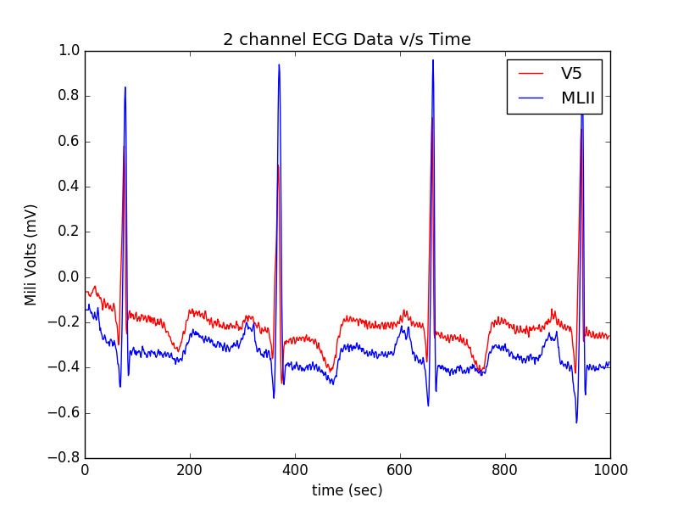
ABOUT THE DATASET
The MIT-BIH Arrhythmia Database was developed by MIT in collaboration with Boston’s Beth Israel Hospital (BIH) in 1980 for arrhythmia detection.
The database contains 48 records, each containing two-channel ECG signals for 30 min duration selected from 24-hr recordings of 47 individuals.
Each ECG record consists of two channel recordings. The first channel recording uses modified lead limb II (MLII) while the second channel recording commonly uses lead V5.

Slide 6
METHODOLOGY
Pre-processing: For reducing noise in ECG signals, the simplest and most widely used is the implementation of recursive digital filters of the infinite impulse response (IIR) , which was made computationally possible with the advance in microcontrollers and microprocessors.
Segmentation: Heartbeat segmentation methods are used for detection of the R peak or the QRS complex. Two measures are usually considered for evaluating the accuracy of heartbeat segmentation: sensitivity and positive predictivity.
Feature Extraction: The features can be extracted in various forms directly from the ECG signal’s morphology in the time domain and/or in the frequency domain or from the cardiac rhythm.
Learning/Classification: Once the set of features has been defined from the heartbeats, models can be built from these data using artificial intelligence algorithms from machine learning and data mining domains for arrhythmia heartbeat classification.

Slide 7
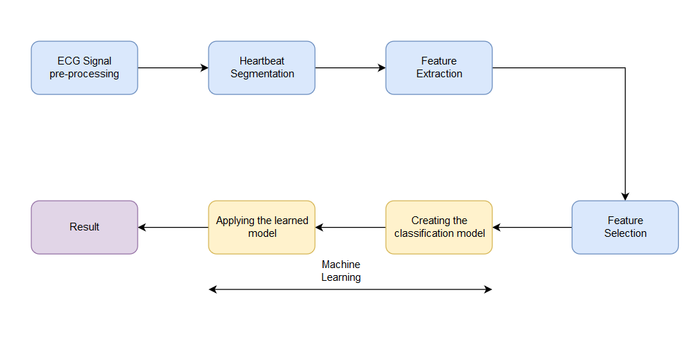
WORKFLOW

Slide 8
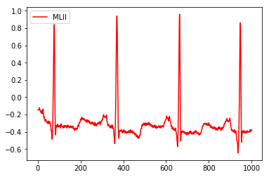
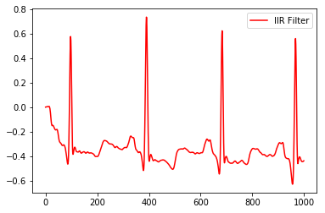
SIGNAL PRE-PROCESSING
ECG signal pre-processing is carried out for reducing noise in ECG signals with the implementation of recursive digital filters of the infinite impulse response (IIR).
These methods work well for the attenuation of the known frequency bands, such as the noise coming from the electrical network (50 Hz or 60 Hz), since they allow quick and easy application of the reject band-filter.

Slide 9
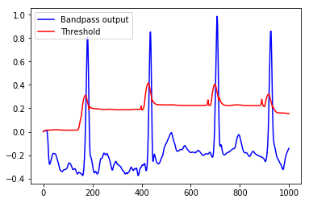
HEARTBEAT SEGMENTATION
Heartbeat segmentation methods are used for detection of the R peak or the QRS complex. The algorithm used is Pan Tompkins algorithm.
Various steps involved in this algorithm:
Differentiation
Squaring
Moving Window
Adaptive thresholding

Slide 10
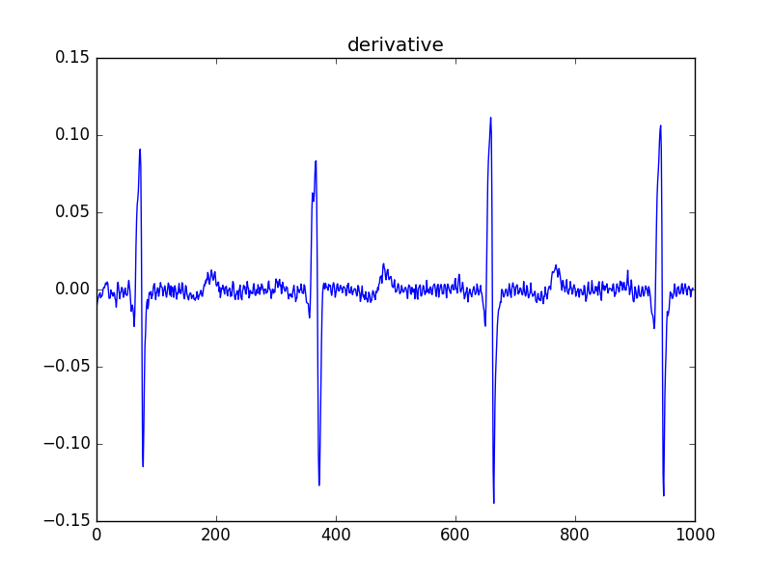
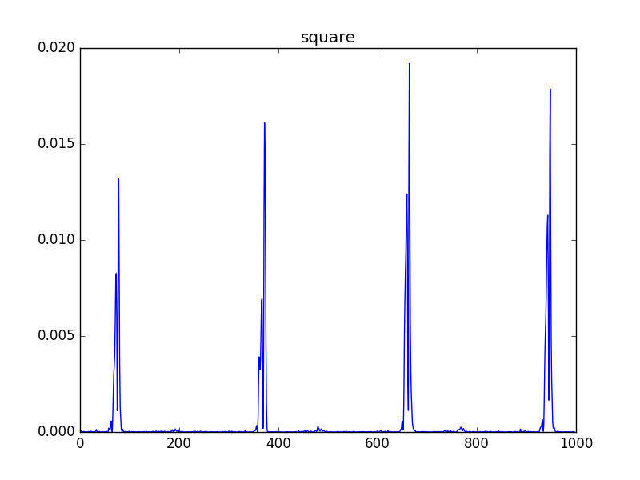
HEARTBEAT SEGMENTATION

Slide 11
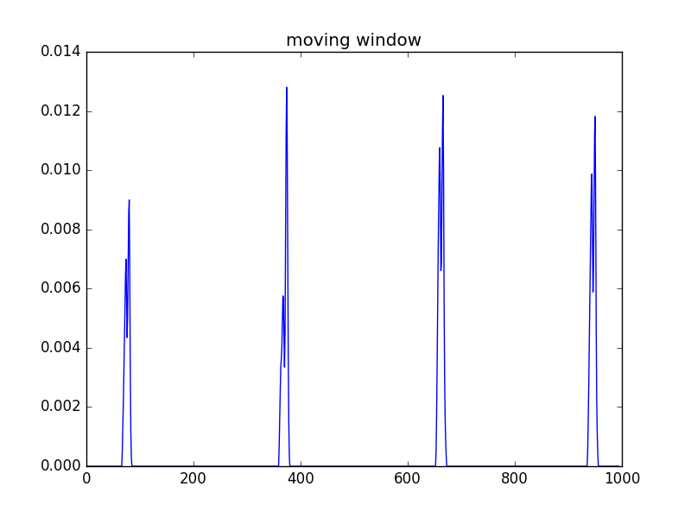
HEARTBEAT SEGMENTATION

Slide 12
HEARTBEAT SEGMENTATION
Sensitivity refers to the test's ability to correctly detect ill patients who do have the condition. In the example of a medical test used to identify a disease, the sensitivity of the test is the proportion of people who test positive for the disease among those who have the disease. Mathematically, this can be expressed as:
Sensitivity = TP/ (TP + FN)
The positive predictivity is defined as
Positive predictivity = TP/ (TP + FP),
where TP (True Positive), FP (False Positive) and FN (False Negative) indicate the number of heartbeats correctly segmented, number of segmentations that do not correspond to the heart-beats, and number of segmentations that were not performed, respectively.

Slide 13
FEATURE EXTRACTION
The features can be extracted in various forms directly from the ECG signal’s morphology in the time domain and/or in the frequency domain or from the cardiac rhythm. Since we know the R-R peaks hence we take 100 points in each R-R interval. After this we pass those sample points to discrete wavelet transform (DWT).

Slide 14
LEARNING ALGORITHMS
We have applied three different Machine Learning Classification Algorithms and tested the accuracy of each. The Algorithms are:
Support Vector Machine (SVM)
Decision Tree
Random Forest

Slide 15
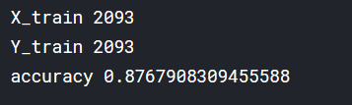
Support Vector Machines (SVM)
Support Vector machines is also known as a large margin classifier . It tries to create a hyper plane or boundary that separates the support vectors of different output labels with largest margin.
Since our data was very complex with large number of features we took a non linear kernel .
It took us about 20 minutes to train our model on this Algorithm and accuracy obtained was 87.68%.

Slide 16
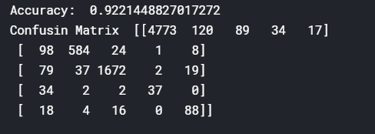
DECISION TREE
Decision tree is a powerful supervised Machine Learning Algorithm which is robust and very fast and trains quickly on the dataset.
It works for both categorical and continuous input and output variables.
Here we split the population or sample into two or more homogenous sets based on most significant differentiator.
It took us only 1 minute to train our model on this Algorithm and we observed that this model performed better than SVM with accuracy of 92.21%.

Slide 17
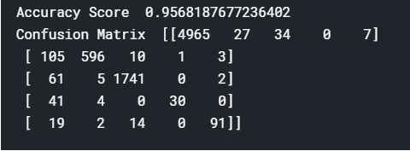
RANDOM FOREST
They area an ensemble learning method for classification , regression and other tasks that operate by constructing a multitude of decision trees at training time and outputting the class that is the mode of the classes of individual trees.
It is also an supervised learning algorithm and is very robust.
It took 4 minutes to train this model and gave the highest accuracy among the three algorithms that we used with accuracy of 95.68%.

Slide 18
HEARTBEAT CLASSIFICATION
CATEGORY | DESCRIPTION
1 | Normal Beats
2 | Atrial, nodal and supraventricular premature beats
3 | Ventricular premature beats
4 | Escape beats
5 | Ventricular flutter-fibrillation beats

Slide 19
TOOLS/RESOURCES
Language Used: Python3
Libraries Used: scikit-Learn, matplotlib, numpy, pandas
Database Used: MIT-BIH Arrhythmia Database developed by MIT in collaboration with Boston’s Beth Israel Hospital (BIH)
Tools Used: Kaggle Kernel

Slide 20
FUTURE SCOPE
Hardware implementation of ECG to take real time data from users and identify the risk of Arrhythmia in them.
Using more advanced machine learning algorithms and artificial neural networks to obtain a better accuracy.
Development of a mobile application for the current implementation so as to reduce cost.

Slide 21
REFERENCES
J. Pan and W. J. Tompkins, “A real-time QRS detection algorithm.” IEEE Trans on biomedical engineering, vol. 32, no. 3, pp. 230–6, Mar. 1985.
Arrhythmia: Causes, symptoms, types and treatment written by Christian Nordqvist (https://www.medicalnewstoday.com/articles/8887.php)
MG Tsipoyras, DI Fotiadis, D Sideris, “Arrythmia Classification using the RR-Interval Duration Signal ” Computers in Cardiology, 2002;29: 485-488
E.J. da S. Luz, W.R. Schwartz, G. Cmara-Chvez, D. Menotti, ECG-based heartbeat classification for arrhythmia detection: a survey, Comput. Methods Prog. Biomed. 127 (Suppl. C) (2016) 144–164

Slide 22
THANK YOU

